Slide 1



GO ELECTRIC DRIVE GREEN
A Drive Green Business Project For London
Designed
by
SHU Consultancy
Group1
2023
Team
Tolulope Lawal
Samuel Emokpae
Tom Hughes
Fasihullah Mohammed
Uchenna Mojekwu
Angela George Varughese

Slide 2
Table of Contents
Project overview
Technical Requirements: Data source and Dataset
Methodology, Design and Implementation
Data Visualisation
Conclusion,Recommendations & Limitations
References
Appendix

Slide 3
Project Overview
Air pollution in London is one of the major concerns for both the Londoners and the several millions of visitors who comes to the city each year (London Council,2019).
The main causes of air pollution in London are; energy generation, industrial activity, and transportation emissions. Even though the city has implemented numerous initiatives to cut emissions, such as the creation of low emission zones, there is still a long way to go.
This proposal is designed for the City Council of London, to address the problem of emissions from the transportation sector.
According to a report published by Public Health,England , the economic cost from from the impacts of air pollution was estimated as £157 million in 2017, it is predicted that costs would increase to £18.6 billion by 2035 if not addressed (Public Health,2017).
A practical way to lower air pollution in the city is through the adoption of Electric Vehicles(EV’s) in London.
EVs have the potential to drastically reduce the quantity of dangerous pollutants emitted into the atmosphere and produce close to zero emissions while in use.

Slide 4
Aims & Objectives
Aims:
To encourage Londoners to transit from non renewable fuel powered vehicles to Electric vehicles (EVs), this will reduce NO₂ emissions from road transport.
Increase public awareness on the benefits of green transportation practices among the people of London
Objectives:
To improve the air quality in London by adopting EV’s that produce close to zero emissions
To reduce both dependence on fossil fuels and UK government’s expenditure on fuel importation
To establish a comprehensive and sustainable eco-friendly transport system in London
Reduce harmful emissions associated with ICE vehicles which contributes to respiratory and cardiovascular diseases

Slide 5
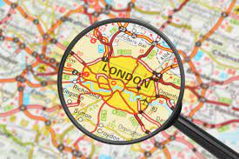
Scope: Why London?
London, the capital city of the United Kingdom has been identified as the most appropriate city to launch this pilot project of EV vehicles. London is considered a world city,characterised by high levels of connectivity and interaction nationally and globally.
Surveys by ONS estimated the mid-year population of London in 2021 as 8.797million. According to Road traffic statistics, London is also one of the busiest cities in the world, with 18.5 billion vehicle miles of traffic were travelled across the 9.2 thousand miles of roads in 2021 such figures significantly contribute towards poor air quality.

Slide 6
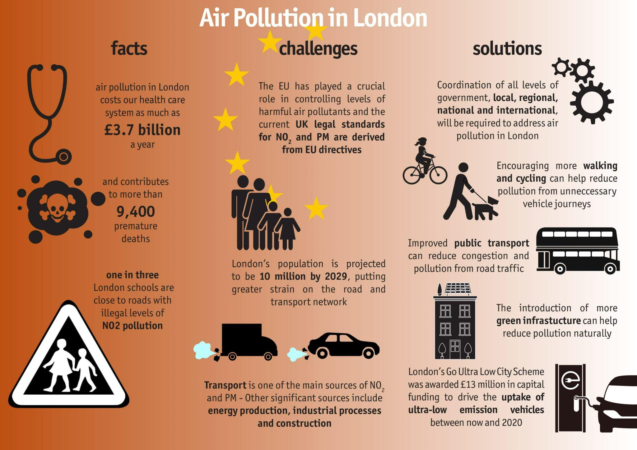
Scale of the problem
Fig 1 : Air Pollution in London
Source: London Councils(Demystifying Air Pollution in London | London Councils)

Slide 7
Key Pollutant: Why NO₂?
NO_{x} are a set of chemically reactive gases composed of nitrogen and oxygen molecules.
Nitrogen oxides are highly toxic and acidic and are considered as air pollutants by environmental agencies. NO₂ causes severe health complications like affecting Foetal development, Low Birth Weights, affects children’s lung growth and contributes to 40,000 deaths every year. (Holgate, 2017)
According to Department of Transport and environment statistics: Autumn 2021 - GOV.UK 35% of Nitrogen Oxides (NO_{x}) emissions and 13% of Particulate Matter(PM2.5) emissions came from transportation sector 12% of NO_{X} emissions came from cars.
Out of the 43 air quality zones in the UK, 38 do not meet the EU limit levels for NO₂, and 16 frequently exceed the threshold for air pollution.
Notes:
The presence of these substances in the air create a lot of health issues, formation of acid rain, fall in the water and air quality. These weak environmental conditions have a negative impact on agriculture, decrease plant growth rate and kill plant tissue. Studies have shown associations of NO₂ in outdoor air with reduced lung development, and respiratory infections in early childhood and effects on lung function in adulthood.
Since they are highly reactive in nature, it increases the likelihood of production of hazardous airborne compounds like ozone(03),corrosive nitric acid and toxic organic nitrates (Johnson et al.,2017).
https://publications.parliament.uk/pa/cm200910/cmselect/cmenvaud/229/22902.htm
https://www.london.gov.uk/sites/default/files/2023-04/Imperial%20College%20London%20Projects%20-%20impacts%20of%20air%20pollution%20across%20the%20life%20course%20%E2%80%93%20evidence%20highlight%20note.pdf

Slide 8
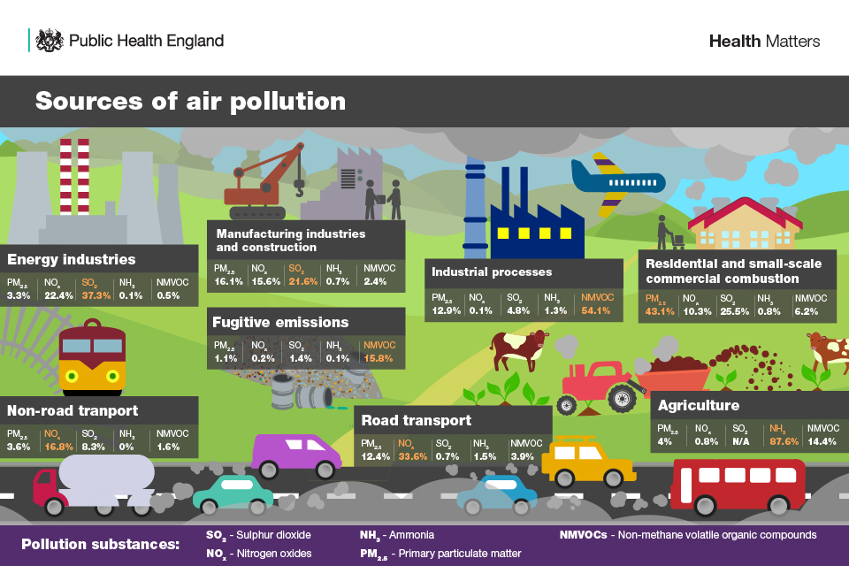
Sources of Air Pollution in UK
Fig 3 Source: GOV.UK

Slide 9
Criteria | Electric vehicles | Traditional ICE
Emissions | Zero emissions from the vehicle | Emissions from the tailpipe
Fuel type | Electricity stored in batteries | Gasoline or diesel
Fuel efficiency | Higher efficiency,lower fuel costs. | Lower efficiency, higher fuel costs.
Maintenance | Lower maintenance costs | Higher maintenance costs.
Government incentives | Eligible for Plug-in car grant and other incentives | No specific incentives
Benefits of Electric Vehicles(EV’s):
Health Benefit: EVs produces zero emissions from the vehicle tailpipe. Results in cleaner air and healthier environment for humans to live.
Economic Benefit: Cost of electricity is lower than gasoline, EVs owners saves money on fuel cost and less dependence foreign on oil.
Lower Maintenance Cost: EVs have fewer moving parts, resulting in less maintenance cost. (Xing et al., 2021), (Hawkins et al., 2013)
Table 1. Benefits of Electric Vehicles

Slide 10
Initial Requirements of the project
Investigate the current state of London’s transportation system and examine its effects on the health of its inhabitants and the environment.
Research and gather data on emission levels,vehicle count,population demographics for all the boroughs of London all for 2018-2021.
Identify the main pollutant from road transport that is harmful to human health and the environment and evaluate its relation with other measures.
Apply findings to achieve the goal of improving air quality in London.
Provide recommendations to promote a sustainable eco friendly transportation network in London.
Give reasons and justification towards any recommendations provided.

Slide 11
BUSINESS QUESTIONS
1. What is the average monthly breakdown of NO₂ emission per borough for 2018-2021?
a. Justification: To identify which boroughs have the overall highest NO₂ concentration.
2. What changes were observed in vehicle counts in each borough in 2020 compared to the previous year 2019, and what were the implications on the emission?
Justification: To identify how lockdown measures implemented during the COVID-19 pandemic impacted vehicle traffic and emissions in each borough
3. Which boroughs have the highest per capita NO₂ emission for 2018-21?
Justification: Per capita emissions allows for comparison of emission levels between boroughs with different population sizes. Since an area with high absolute emissions may not necessarily be the area with the highest per capita emissions.
4. What is the average annual NO₂ emission per vehicle in each borough for the period 2018-2021?
Justification: To obtain a normalized NO₂ output and try to find any relationship between vehicles and NO₂
5. What is the relationship between vehicle count, NO₂ and time/hour of the day for the period 2018-2021?
Justification: To understand the impact of road traffic on NO₂ emission levels at different times of the day, during what times of the day are the emissions high.

Slide 12
Review of Various Data sets
Emission DataSet UK local authority and regional greenhouse gas emissions national statistics, 2005 to 2020 ,GOV.UK
Vehicle Count in London Department for Transport ,GOV.UK
Death due to respiratory issues, Statista
Reasons for discarding the reviewed datasets:
The emission dataset is aggregated annually, but we needed a more detailed level of granularity in the dataset, i.e monthly or hourly.
The vehicle dataset again is aggregated annually and the count of vehicles driving through the borough gives accurate information about the number of vehicles possibly contributing to the emission than the number of licensed vehicles in the borough.
Differences in time frame among the datasets

Slide 13
Selected Datasets: These are obtained from credible UK agencies, hence legitimate and reliable,
they have the desired level of granularity and the required uniform time frame and meets the business requirements
Datasets | Sources | Information | Links | Duration | Level of Granularity
Vehicle count | Open Air (King's college London Network) | Pollutants | London road traffic statistics | 2018-2021 | Hourly
Emission | Department for Transport,Road Traffic Statistics | Vehicle counts recorded at count points in London Boroughs | OpenAir API | 2018-2021 | Hourly
Population | London Data Store | Population of London | Land Area and Population Density, Ward and Borough - London Datastore | 2018-2021 | Annual
Table 2: Selected Datasets

Slide 14
Key Features and joining the Dataset
Metrics: NO₂
Dimensions: Borough
Year
Month
Hour
Borough, Date and Hour these are the key features that were used to join the Emission and vehicle data sets. The population dataset was joined by Borough and Year (refer to ETL process)

Slide 15


Recommended Softwares
Data processing tools include: R programming language (refer appendix table for package) + Apache Spark and DPLYR (package)
R programming language was identified for data manipulation and analysis purposes across all the three datasets.
Such as;
Data cleaning to identify missing values
Identify any outliers in all data sets
Data integrity checks
Data aggregation to obtain summary statistics for analysis purposes
Apache Spark: Provides a distributed computing system with cleaning techniques such as selection, filtering and aggregation suitable for large datasets, which are then applied by the DPLYR package in R

Slide 16
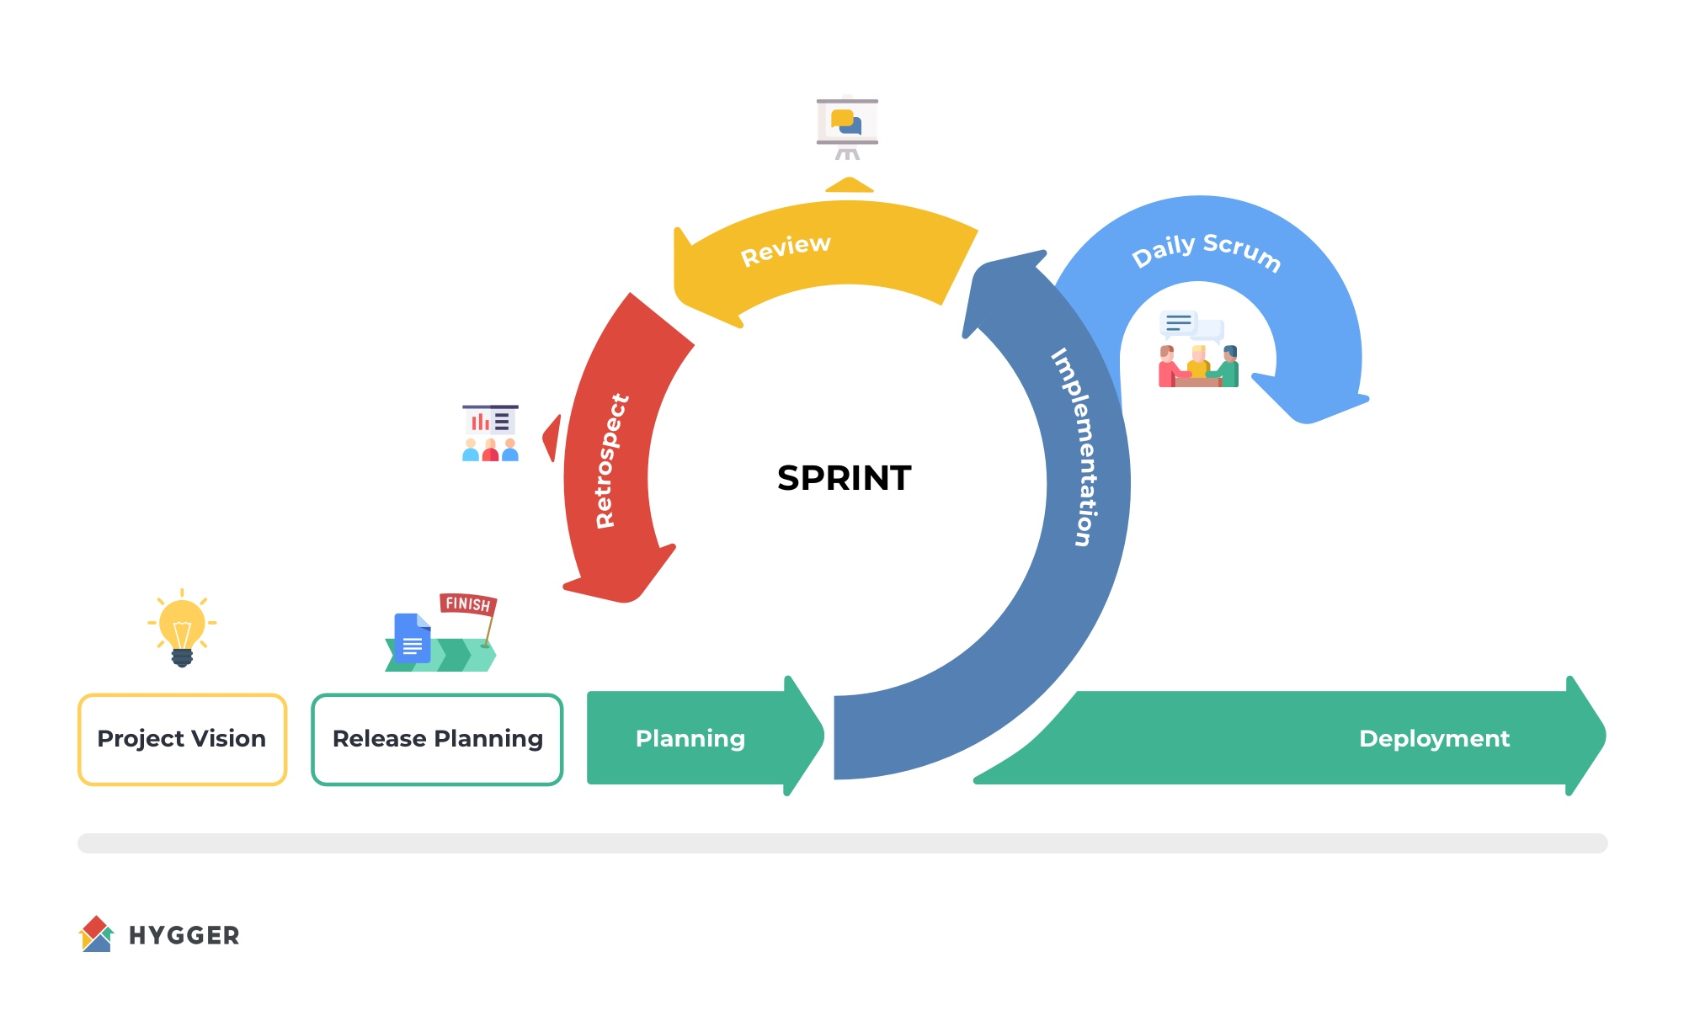
Development Methodologies
Division of labour
Iterative planning
Continuous checks and improvements
Constant communication and feedback
Adapting to incorporate changes
Fig 4: Agile Methodology-Scrum

Slide 17
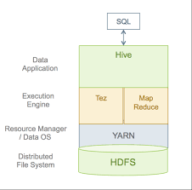
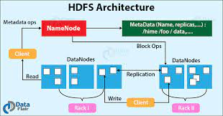
BDDS Tools and DI Techniques
Fig 6 : HDFS Architecture
Fig 5 : HIVE SQL execution process
Notes:
Does not need voice over?

Slide 18






BDDS Tools & DI Techniques
Notes:
Throughout our project, we implemented a number of BDDS and Data Integration techniques. These include using R and HIVE to establish our data marts, the Hadoop file system to effectively store the large files and Apache spark to
Efficiently clean and process our data. Finally we used a few assisting technologies, such as Github to store and share code and MS access to visually represent our relational database.

Slide 19
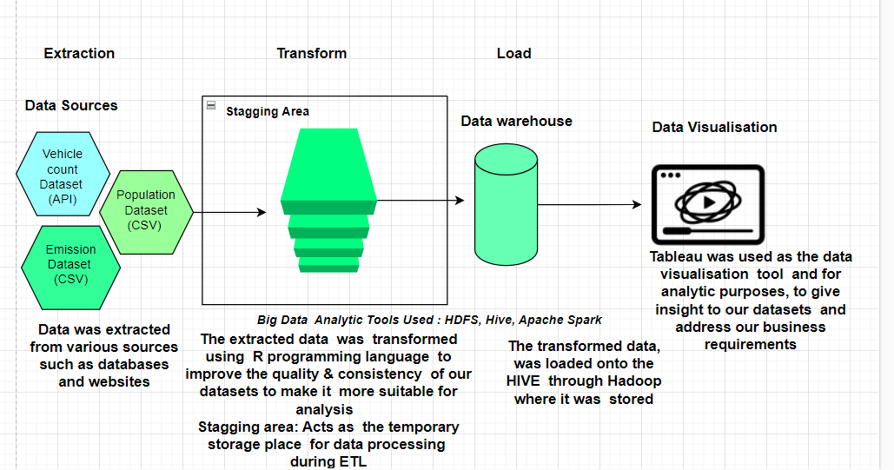

Solution Architecture / Workflow
Staging
Fig 7: Solution Architecture
Notes:
We followed the extract transform load architecture for developing our datawarehouse. ->
The extraction phase included downloading two of our datasets, population and vehicle count, while the emission dataset was access via the openair api in R ->
The transform phase included using libraries in such as apache spark and DPLYR to preprocess and clean our data ->
The Load phase included using the dbwritetable function in R to load our Dim and Fact tables into HIVE, here they were stored on the Hadoop file system as our data warehouse ->
Finally we connected Tableau to HIVE to visualise our data

Slide 20
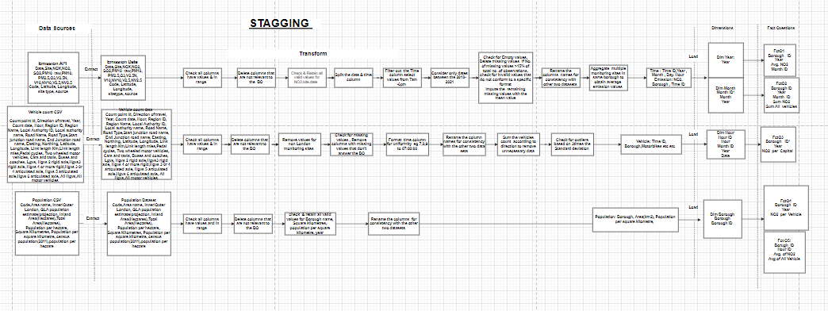
Data Staging Process
Staging
Fig 8 : Data Staging Processes (Appendix: 1)
Notes:
More in depth look at the ETL stages mentioned in the previous slide, a clearer image is available in the appendix

Slide 21
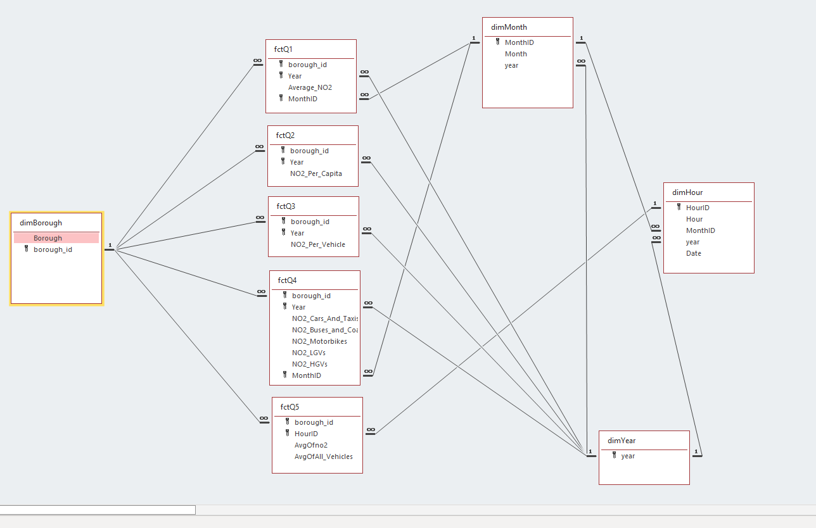
STAR CONSTELLATION SCHEMA WITH SNOWFLAKE
Fig 9 : Star Constellation Schema with Snowflake
Notes:
We used Microsoft Access to visualise the relationship between the tables within our data warehous

Slide 22
ETL (Extract Transform Load) Vs ELT (Extract Load Transform)
ETL is the data integration approach implemented since in our case, transformation occurs before the load phase.
This is appropriate as our data is in a structured format (relational) and there is no need for scalability to be accounted for.
We have predetermined goals for analysis - analysis is faster once transformation takes place.
Disadvantages of ELT;
Time consuming; the transformation process can take a long time, which can lead to delays in data analysis and decision making, this is not feasible.
It’s not cost effective, ELT is an expensive process that requires significant
investment in hardware and software, high database maintenance costs
Notes:
Why we used ETL as opposed to ELT.
ETL more appropriate for structured data, such as our own, as no need for scalability ->
Also, because we have pre-determined goals in the form of business questions it makes sense to transform first for faster analysis

Slide 23
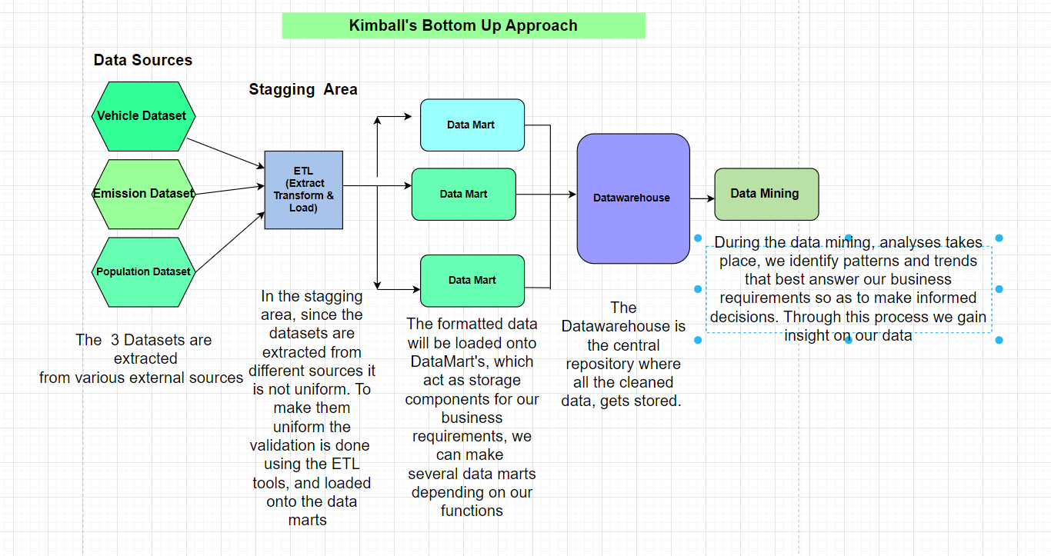
Fig 10 : Kimball'S Bottom Up Approach
Notes:
We choose to implement the Bottom Up Approach when designing our Data warehouse, as our data was relatively small (in the world of big data) and as mentioned previously we have
Pre determined businesses questions, thus it makes sense to produce our Data marts earlier in the process as we have no intentions of forming any more. Finally, it was more time efficient to implement as we didn’t need to develop a comprehensive design upfront.

Slide 24
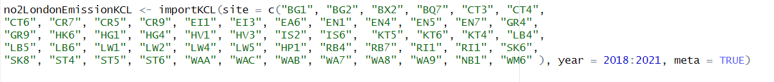
Data staging - Extract
Import emission data from King's College London (KCL) Air Quality Network
Provide the site codes of london monitoring sites
Mention the time-frame
Fig 11 : Extraction of data from API
Notes:
So in data extrac

Slide 25
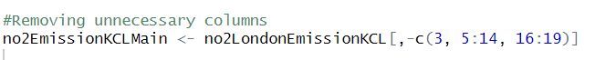
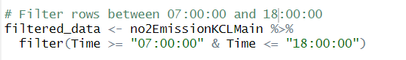
Data staging - Transform
Fig11: Removing unnecessary columns
Fig 12: Separate date & time
Filtering out rows to be consistent with the vehicle dataset which has data only in these times
Fig 13 : Filtering rows according to time

Slide 26
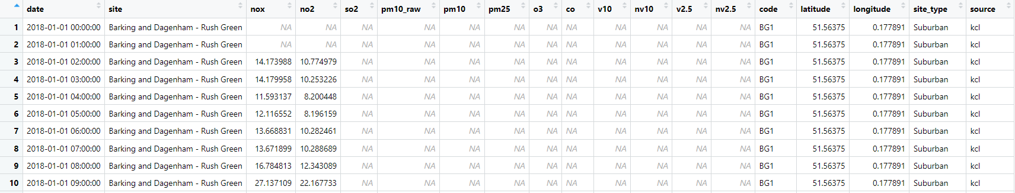

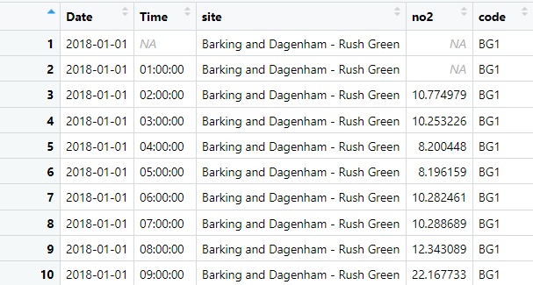
Raw data transformed after removing redundant columns, splitting the Date column in to Date and Hour and filtering data between 07:00:00 to 18:00:00
Fig 13 : Formatting the time on raw data

Slide 27
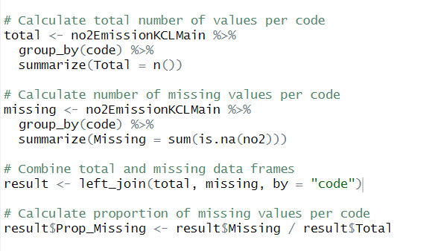
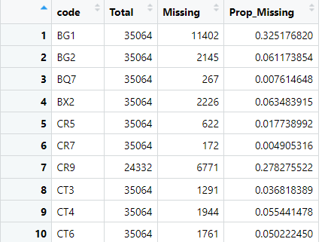
Data staging - Transform
Fig 14: Transforming( Missing values)
Calculating the total number of observations and NAs per monitoring site (grouped by code)

Slide 28
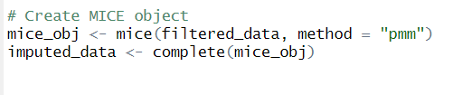
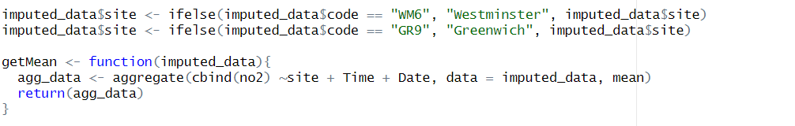
Data staging - Transform
Remove monitoring sites with more than 15% empty values
Impute missing values using predictive mean matching in MICE package because it’s useful for skewed data (Andridge & Little, 2010) (Appendix 5)
Rename monitoring sites to the borough name
calculate the mean NO₂ concentration for each combination of "site", "Time", and "Date" in the imputed_data data frame. We merged the multiple monitoring sites in each borough using mean for each combination of time and date.
Fig 15: Transform(Deleting,MICE)

Slide 29
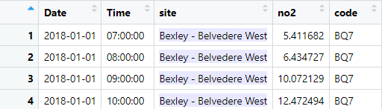
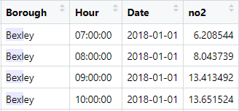
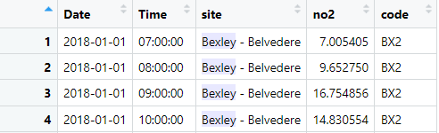
Bexley site 1
Bexley site 2
Fig 16: Merging different Monitoring sites into one borough

Slide 30
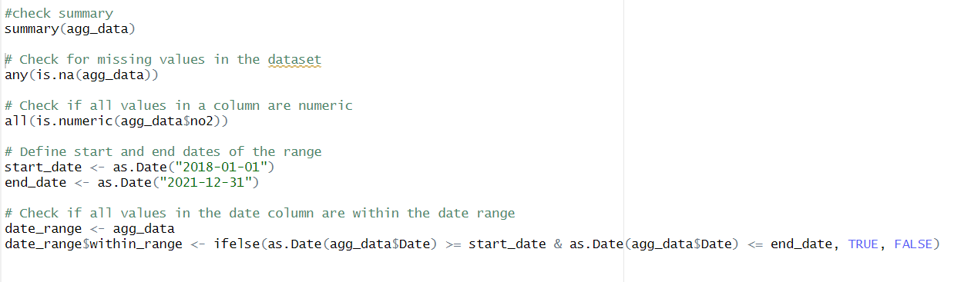
Data Quality Checks
Fig 17: Data Quality checks

Slide 31
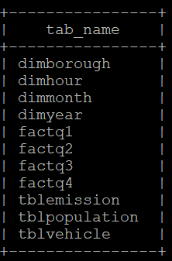
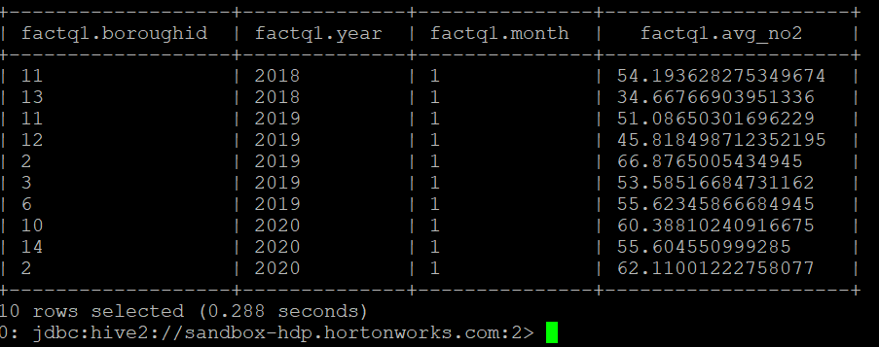
Data staging - Load
Code to connect R to Hive database
Code to write data to hive tables
Tab 3 : Loading of Fact table 1

Slide 32
Data validity:
Dataset | NA’s | Total observation
Emission raw | 134044 | 1854968
Filtered data | 47294 | 853944
Final
Fig 18 :

Slide 33
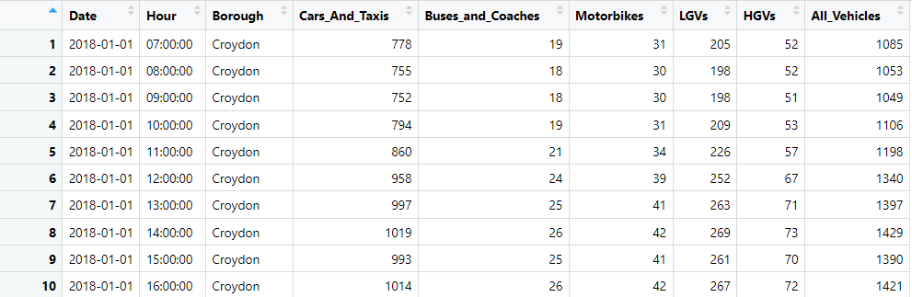
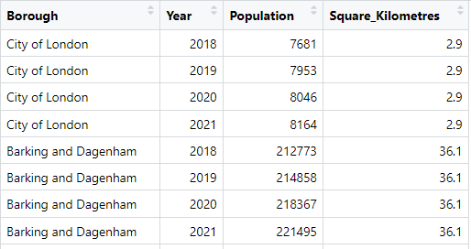
Final Datasets
Vehicle dataset
Emission dataset
Population dataset
Fig 19 : Final datasets

Slide 34
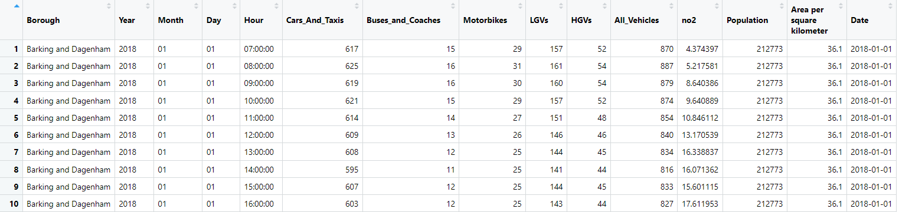
Merged Dataset (Emission +
Vehicle count + Population)
Fig 20: Merged Dataset

Slide 35
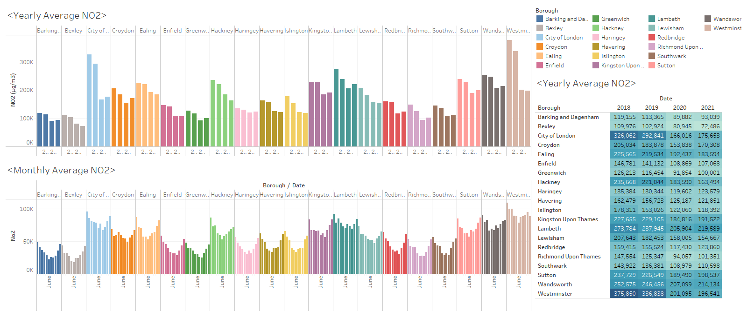
Average monthly breakdown of NO₂ emission per borough for the period 2018-2021
Observations:
Westminster, Wandsworth, Sutton & Lambeth are with the highest pollution.
General trend of pollution dropping mid-year.
Substantial drop in NO₂ from 2019 to 2020.
Fig 21: Average Monthly breakdown of NO₂ emission per borough

Slide 36
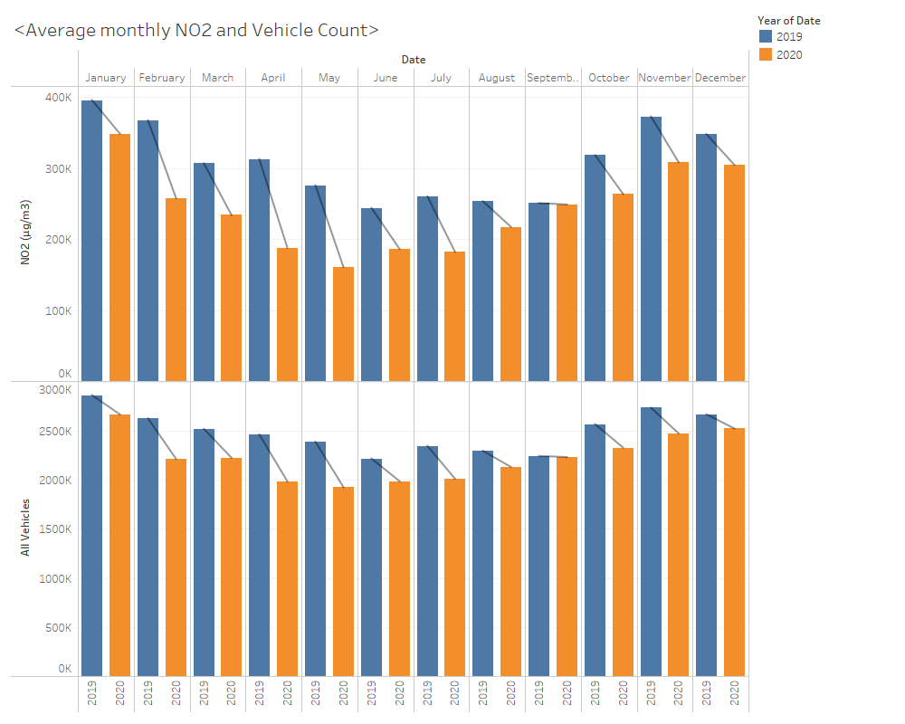
Vehicle counts and emissions per borough in 2020 compared to the previous year 2019, and what were the implications on the emission
Observations:
A dip in both Emission and Vehicle count from Feb to June, 1st COVID-19 lockdown period between 2019 & 2020.
Both emission and the vehicle count are getting back to pre-pandemic levels from June 2020, as the lockdown restrictions are eased.
Fig 22: Vehicle count & Emission per borough in 2020&19
Notes:
Comparing both years, observation shows a decline of the yearly difference(for both NO₂ and vehicle count) from feb up till June when the difference upwards when life returned to normal, just like pre pandemic era

Slide 37
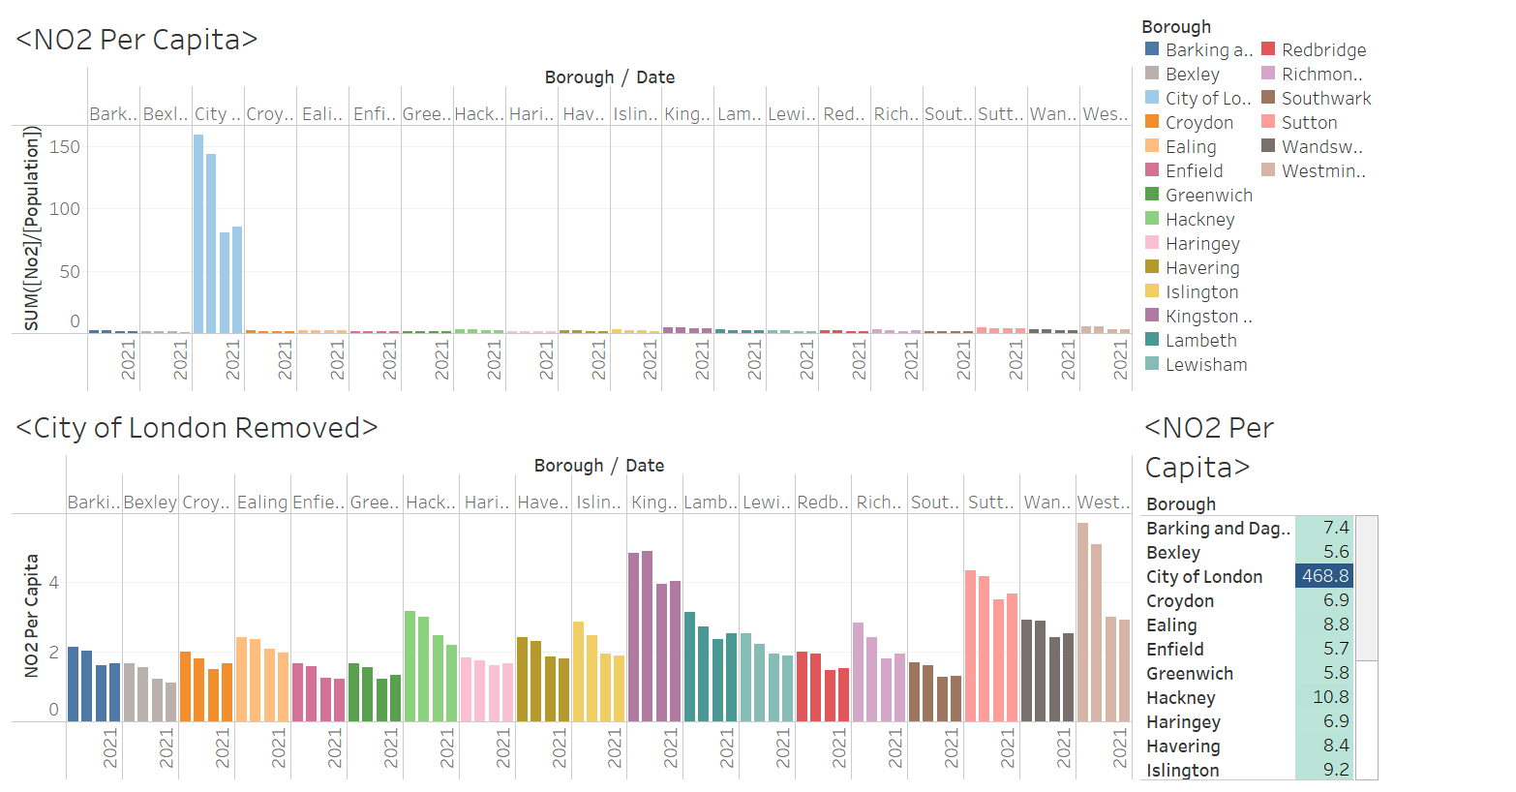
Per capita NO₂ emission for 2018-21
Observations:
City of London borough looks like an anomaly because of the low population present there.
Kingston Upon Thames has the highest emission per person, followed by Westminster.
Fig 23: Per Capita NO₂ emission for 2018-21
Notes:
Compare with the top boroughs(kingston upon thames&westminster) from Q1 to now, lambeth showed more overall emission but per capita is comparatively less. Hence add this as a reason of justification for why per capita is a better metric to judge.

Slide 38
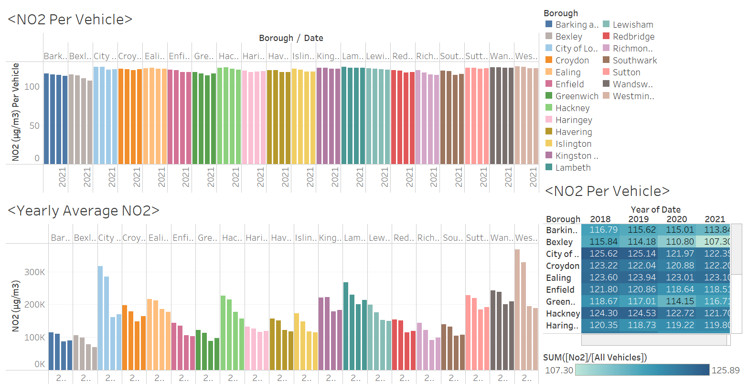
Average annual NO₂ emission per vehicle in each borough for the period 2018-2021
Most boroughs show slight decrease in average NO₂ per vehicle.
Difference between 2019 & 2020 is less noticeable in normalised - suggests possible correlation
Fig 24: Average annual NO₂ per vehicle in each borough 2018-21
Notes:
An observation of the two graphs suggests that normalizing NO₂ by vehicle count can reduce the noticeable drop in NO₂ levels between 2019 and 2020. The first graph, which shows the raw NO₂ levels, displays a clear drop in NO₂ levels from 2019 to 2020. However, the second graph, which shows NO₂ normalized by vehicle count, displays a less pronounced drop in NO₂ levels between the two years. This reduction in the noticeable drop suggests that vehicle count may be contributing to the observed pattern, and normalizing NO₂ by vehicle count can be a useful way to control for this effect.
Therefore, when we normalize NO₂ by vehicle count, the change in NO₂ levels between 2019 and 2020 appears to be less pronounced because we are controlling for the impact of changes in vehicle count on NO₂ levels.

Slide 39
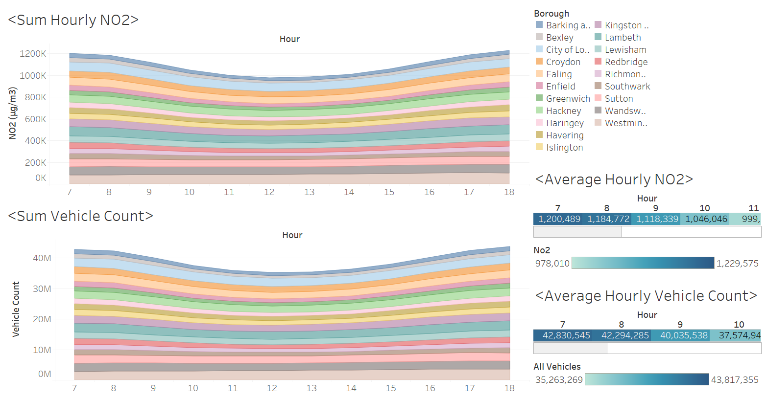
Relationship between vehicle count, NO₂ and time/hour of the day for the period 2018-2021
Observation:
Similar trends in both vehicles and emission.
Confirms the relation between the number of vehicles on road and the emission
Fig 25: Relationship between vehicle count,NO₂ and hour of the day for 2018-21

Slide 40
Conclusions
The analysis done for this project highly suggests that London's vehicles do contribute to the presence of NO₂ in the atmosphere. Although there are regulations in place to control vehicle emissions in London, the air quality remains alarmingly poor, which contributes to almost 48,000 fatalities annually (Holgate, 2017)
This indicates that further initiatives are required to reduce emission levels.
The introduction of Electric Vehicles will have a positive impact on the environment, since they have close to zero emissions and along with the measures already in place will bring down emission from vehicles at a rapid pace
To encourage a cleaner, better, and more sustainable future for all, where people can live without having to compromise on their health or the environment, this pilot initiative can be mirrored in other cities throughout the UK. The adoption of EVs can be phased in, beginning in the boroughs with the highest NO₂ concentration per capita

Slide 41
Recommendations
Introduce electric vehicles in a phased manner starting with public transportation in the boroughs with highest per capita emission, like Westminster, Kingston Upon Thames, Sutton.
Promote the use of public transportation during rush hours to lower the amount of cars on the road during rush hour, which is when they make up the bulk of all vehicles on the road. (Appendix 2)
A comprehensive purchase incentive plan for zero emission commercial vehicles.
Invest in building better electric charging stations infrastructure, especially in boroughs with high per capita emission.
Provide tax benefits and purchase incentives for electric vehicles users in London Boroughs.
Promote public awareness about the harmful effects of NO₂ to humans and environment.
Promote more renewable electricity generating sources.
Install more monitoring sites in each borough to capture NO₂ to get more precise insights.

Slide 42
Limitations
NO₂ Data not available for few boroughs as not all monitoring sites capture NO₂.
Other explanatory variables responsible for NO₂ levels
Correlation ≠ Causation
Population not representative of all those that visit the borough (Viz. City of London)
Vehicle count and NO₂ monitoring sites not located at the same point within borough
Site may not be representative of borough as a whole
No data available on NO₂ emission for each type of vehicle
Cannot conclude which vehicle type are most polluting
No data available to distinguish between the number of electric and non-electric vehicles in our vehicle_dataset.
Assumption that most are still combustion engine powered vehicles

Slide 43
APPENDIX
Items Included:
1: Team Members Roles & Justification
2: Hourly average NO₂ emission of vehicles by type per borough
3.Fields available in the datasets
4. Packages & Functions
5. Code of execution
6. Staging Process

Slide 44
REFERENCES
Andridge, R., & Little, R. J. A. (2010). A Review of Hot Deck Imputation for Survey Non-response. International Statistical Review, 78(1), 40–64. https://doi.org/10.1111/j.1751-5823.2010.00103.x
Department of Environment, Food & Rural Affairs, Public Health(2017) https://laqm.defra.gov.uk/air-quality/guidance/public-health/
Hawkins, T. R., Singh, B., Majeau‐Bettez, G., & Strømman, A. H. (2013). Comparative environmental life cycle assessment of conventional and electric vehicles. Journal of Industrial Ecology, 17(1), 53-64.
Holgate, S. T. (2017). ‘Every breath we take: the lifelong impact of air pollution’ – a call for action. Clinical Medicine, 17(1), 8–12. https://doi.org/10.7861/clinmedicine.17-1-8
London Councils(2019)Air Quality Polling ,London Councils, https://www.londoncouncils.gov.uk/our-key-themes/environment/air-quality-london/air-quality-public-polling/2019-air-quality-polling
London Councils (2017)(Demystifying Air Pollution in London | London Councils)
https://www.londoncouncils.gov.uk/node/33224
Xing, J., Leard, B., & Li, S. (2021). What does an electric vehicle replace?. Elsevier BV. 10.1016/j.jeem.2021.102432
Yong, J. Y., Ramachandaramurthy, V. K., Tan, K. M., & Mithulananthan, N. (2015). A review on the state-of-the-art technologies of electric vehicle, its impacts and prospects. Renewable and Sustainable Energy Reviews, 49, 365-385.

